Slide 1
Motion under Gravity

Slide 2
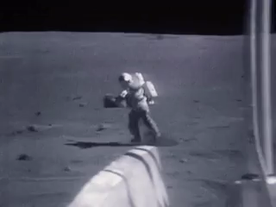
Welcome to this Smart Lesson on motion under gravity!
After completing this Smart Lesson you will be able to:
Describe the motion of objects affected by gravity.
Perform calculations of motion of objects that are affected by gravity.
Describe the horizontal motion of objects affected by gravity.
Perform calculations of horizontal motion.

Slide 3
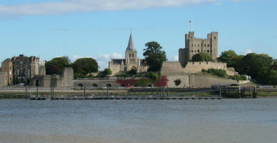
In this lesson we will be learning about motion under gravity in the context of defending a castle.
Castle defences include high walls, gates, and projectiles.
This is Rochester Castle, which was besieged and subsequently taken by King John in 1215.

Slide 4
Vertical Acceleration A dropped object moves in a straight line downward. The vertical acceleration of any object is 9.8 ms−2 downward due to gravity. Taking up to be positive, and down to be negative, we can say that the acceleration due to gravity is −9.8 ms−2.

Slide 5
Vertical Velocity A dropped object begins moving from rest, so the initial vertical velocity of a dropped object is 0 ms−1. The vertical velocity increases as the object accelerates downward, only stopping once it hits the ground. The final velocity of this object is 6 ms−1 downward. Taking up to be positive, and down to be negative, we can say that the final velocity of the object is −6 ms−1.

Slide 6
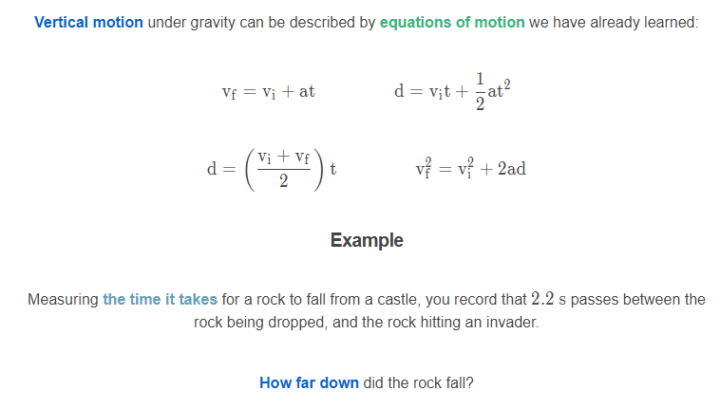

Slide 7
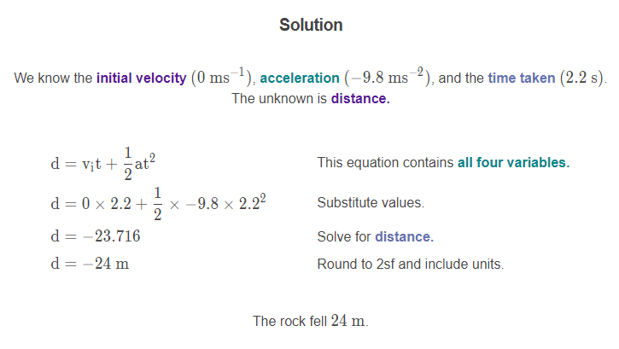

Slide 8
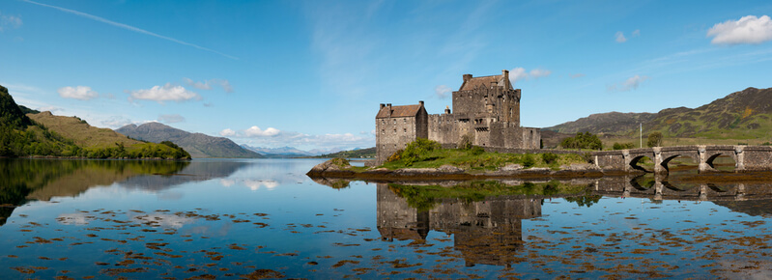
Example
How fast was the same rock moving when it hit the invader?

Slide 9
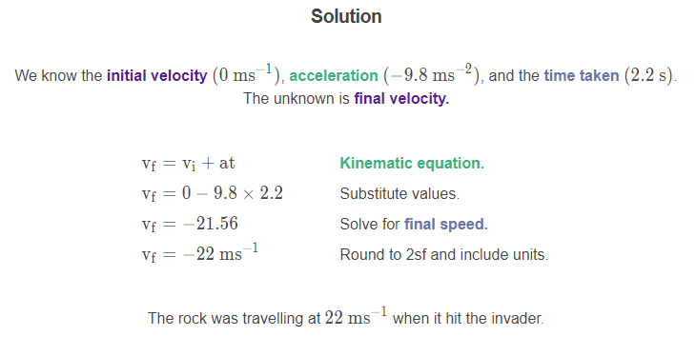

Slide 10
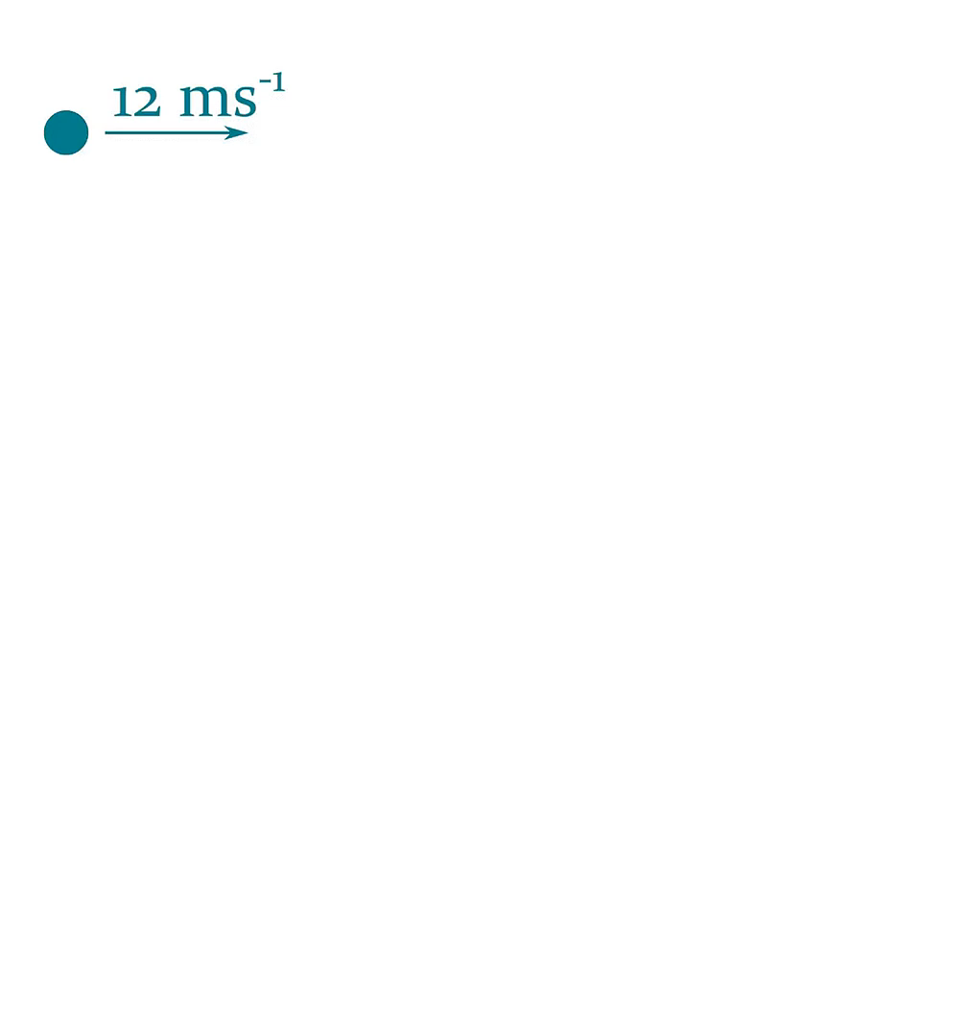
Horizontal Motion
An object that is fired sideways instead of dropped will continue to move sideways as it falls to the ground.
The horizontal velocity of the object stays constant, as there is no horizontal acceleration.

Slide 11

The only force acting on any object that has been fired sideways is the force of gravity. This means that the vertical acceleration is the same as if the object was dropped.
In fact, if we drop one object and fire another sideways, they'll hit the ground at the same time!

Slide 12
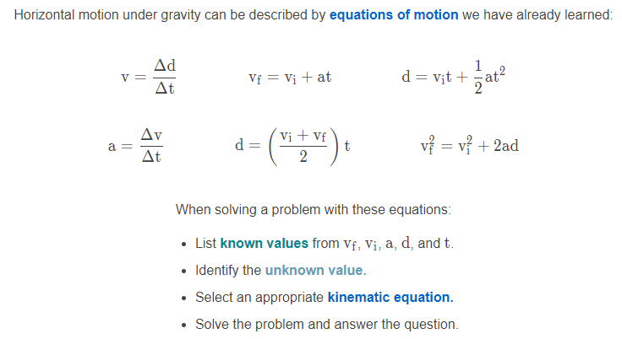

Slide 13
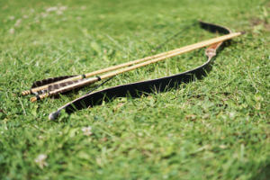
Example
Let's look at an arrow that has been fired sideways off the top of a castle at 45 ms−1. The castle is 25 m tall.
How long will the arrow take to hit the ground?

Slide 14
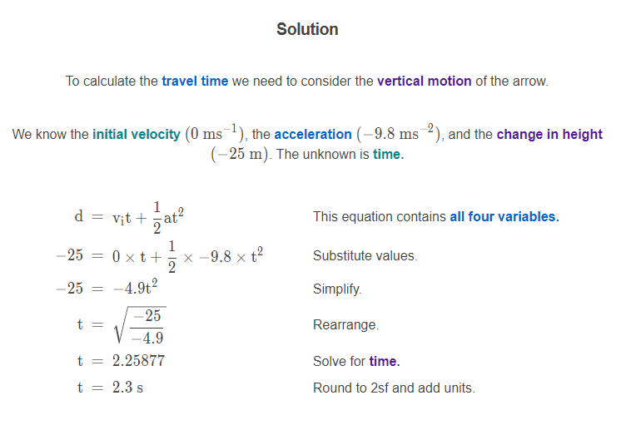

Slide 15

Example
What is the horizontal distance travelled by the arrow in the previous question?

Slide 16
